Slide 1
Module 16

Slide 2
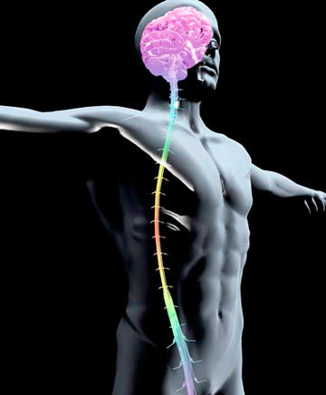
Brain •
Central nervous system is a delicate structure composed of brain and spinal cord.
Spinal cord •

Slide 3
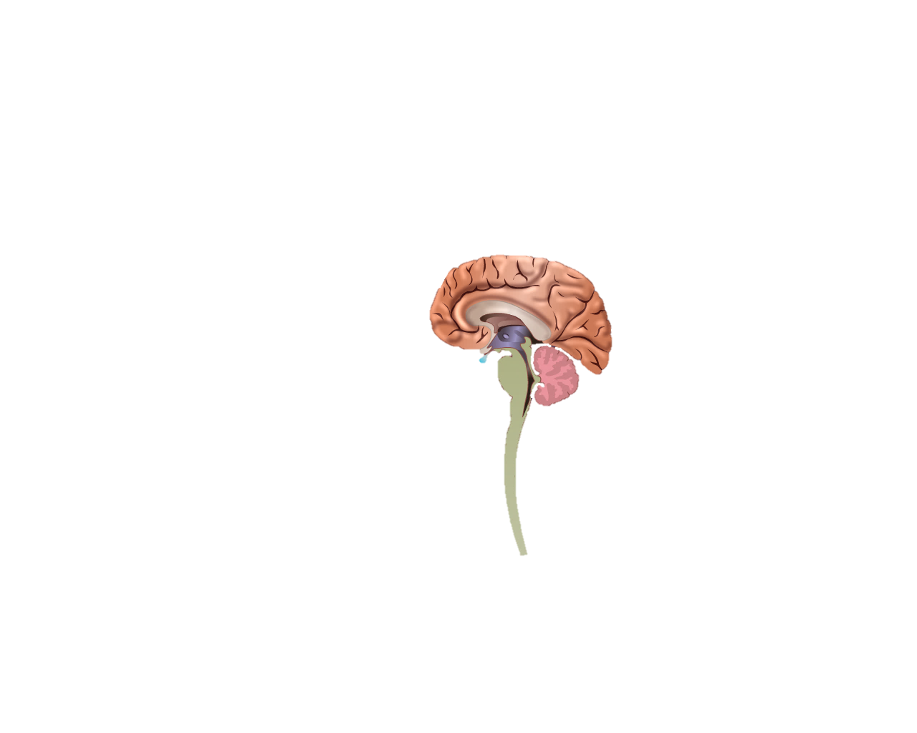

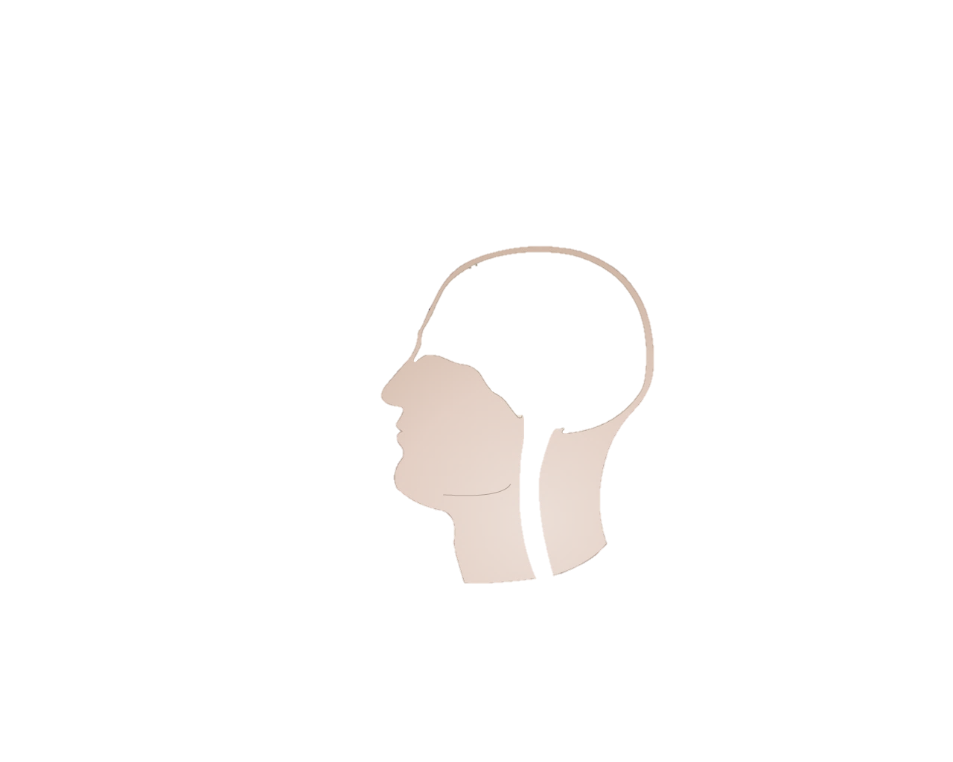
The brain is protected by a bony structure called as
Spinal cord is protected by vertebral column or the back bone.
Cavities present on the different part of the brain are known as ventricles
The long cavity of the spinal cord is called as central canal.
Now let’s understand the structure of brain :
Protective membranes called the meninges are presence between the soft CNS and bone.
The ventricle central canal and space between the meninges are filled with cerebro spinal fluid (CSF)
Function of CSF :
Nourishment
Protection by absorbing mechanical shock
Cranium/Skull
Meninges
Ventricles
Brain and spinal cord (CNS)
Cerebro Spinal Fluid (CSF)
Vertebral Column
Central canal

Slide 4
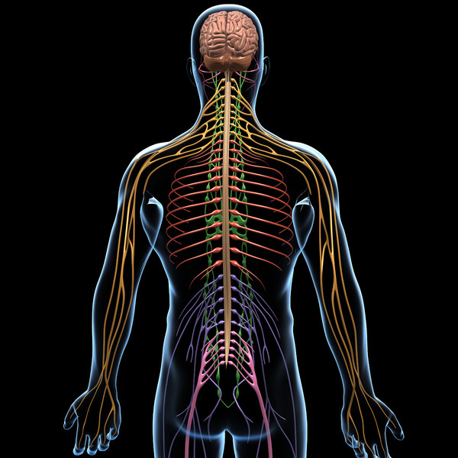
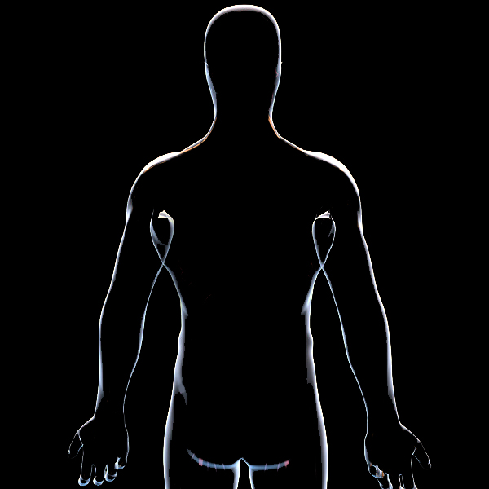

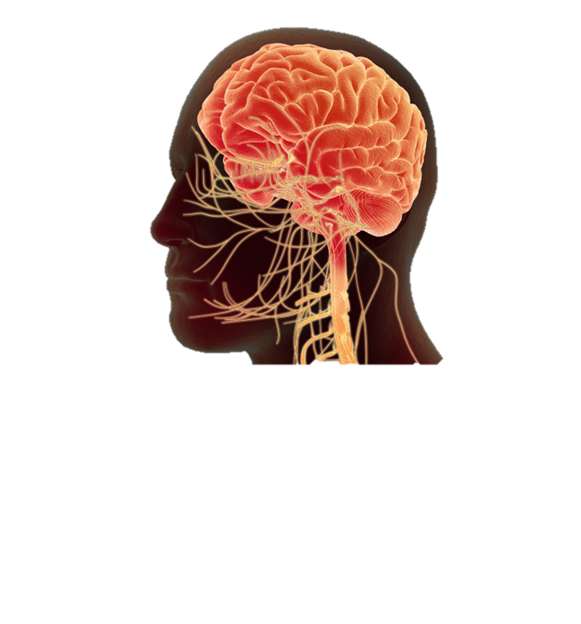
Spinal nerves
&
Cranial nerves
Nerves arises from the brain are called as cranial nerves
Make
Peripheral Nervous System
Spinal nerves
Cranial nerves
Nerves arising from the spinal cord are called as spinal nerves

Slide 5
Peripheral nervous system controls voluntary actions like
Running
Clapping
Playing

Slide 6
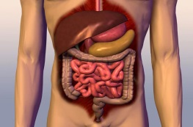
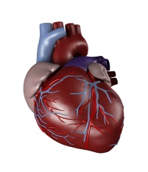
Autonomic nervous system controls involuntary actions like
Respiration
Digestive system
Circulatory system

Slide 7
Thank You

